Slide 1


Team 36: Self-Navigating, Obstacle Avoiding Robot
Bi-Weekly Update 4 Teammates:
Arkadi Zhanov
Nathan Sommer
Nikolai Paderin Sponsor: Stavros Kalafatis
Notes:
Michelle

Slide 2
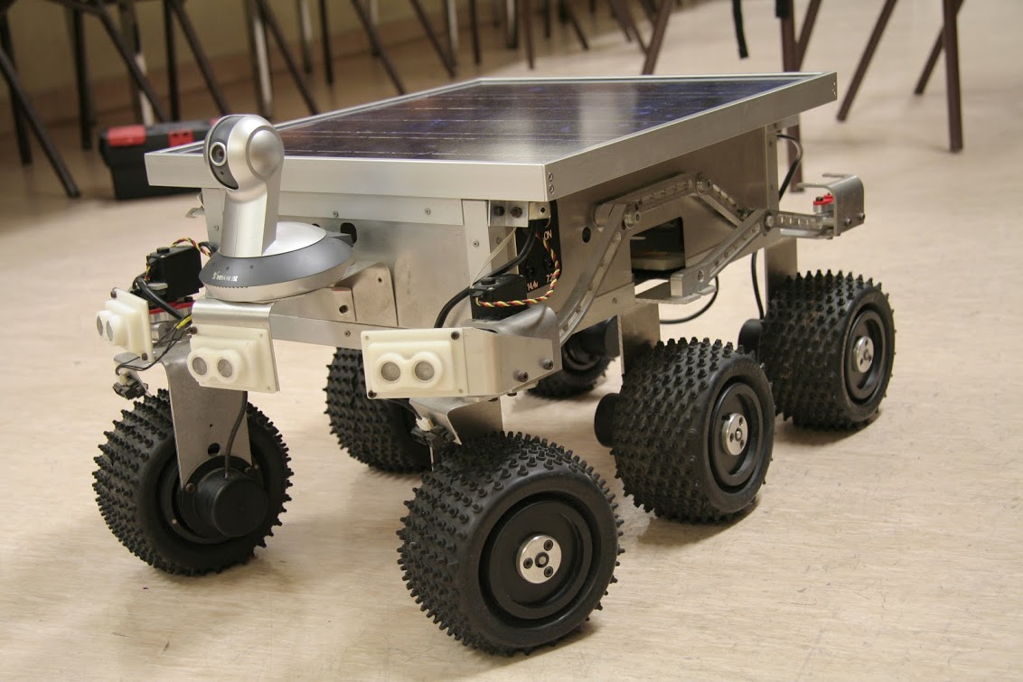
Project Summary
Create a system that takes in a point on a map as the rover’s destination, creates a route for the rover, and gets the rover to its destination and back while avoiding obstacles.
The main motivation for this project is for application in military settings such as aid delivery to wounded soldiers in the battlefield or local, residential delivery of food or mail.
Notes:
Kyle

Slide 3
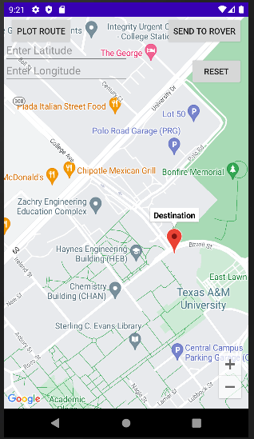
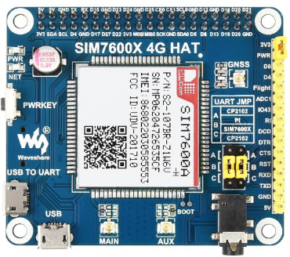
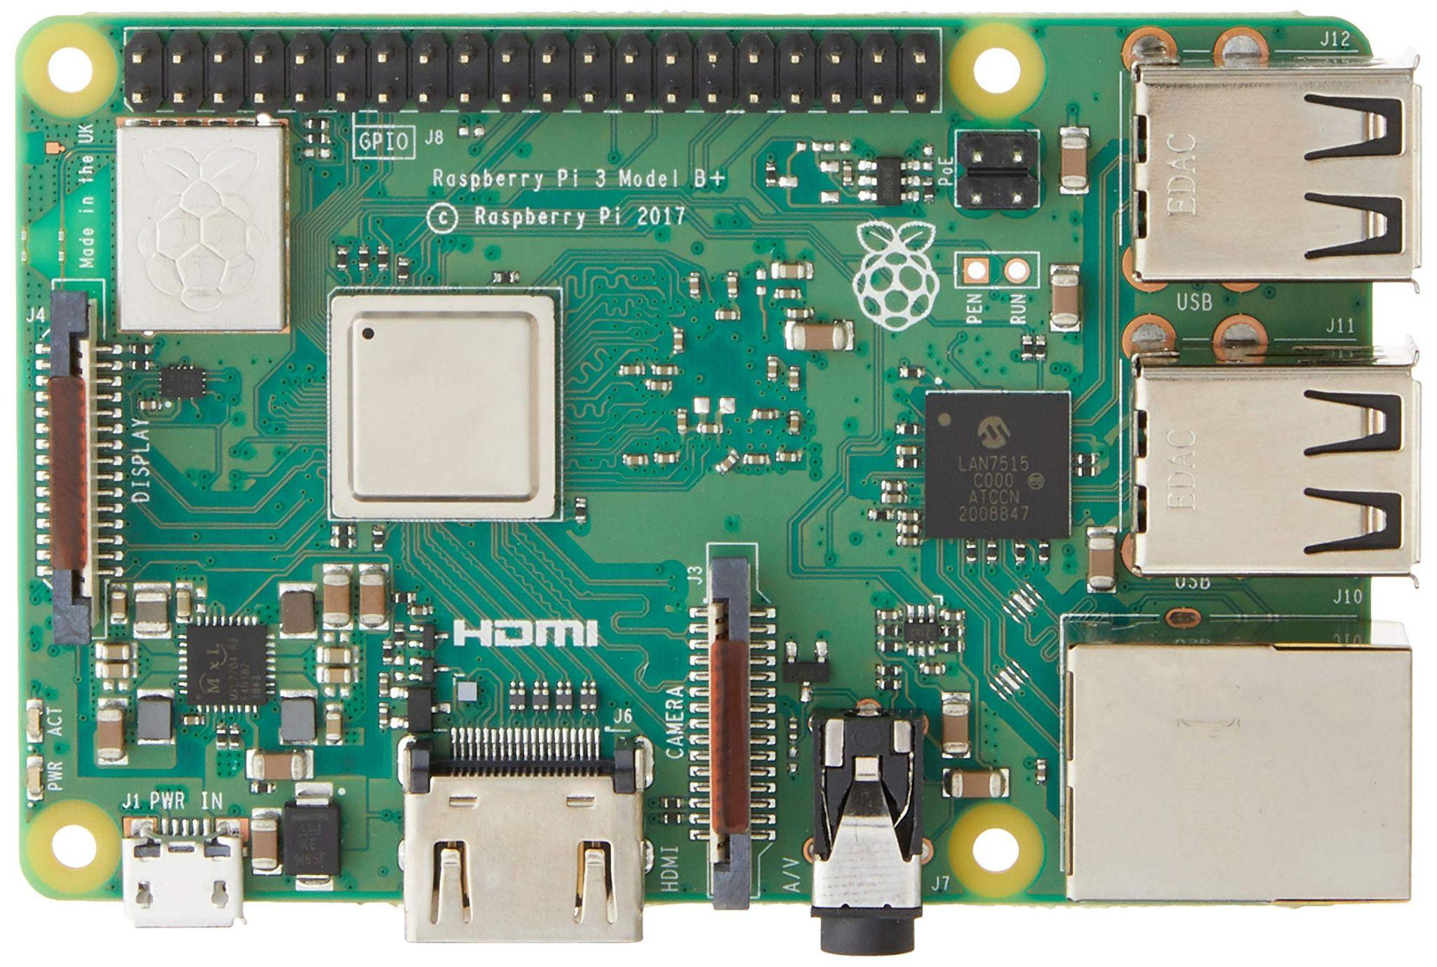
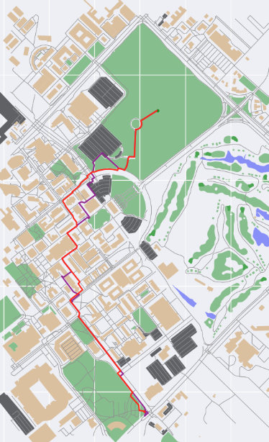
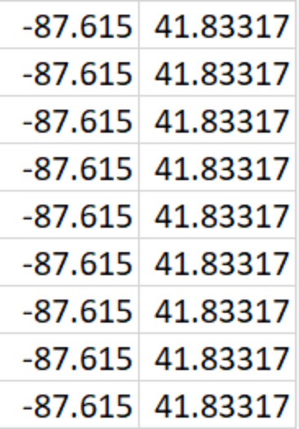
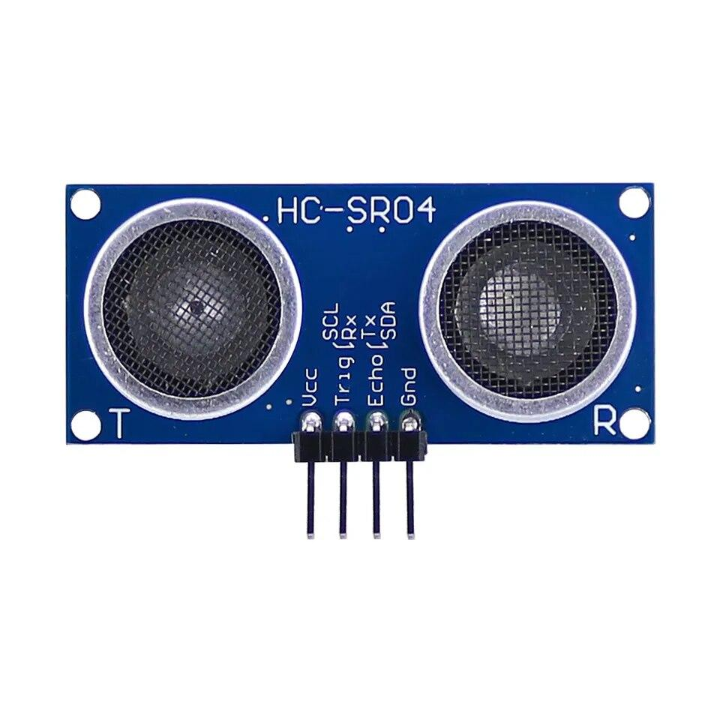
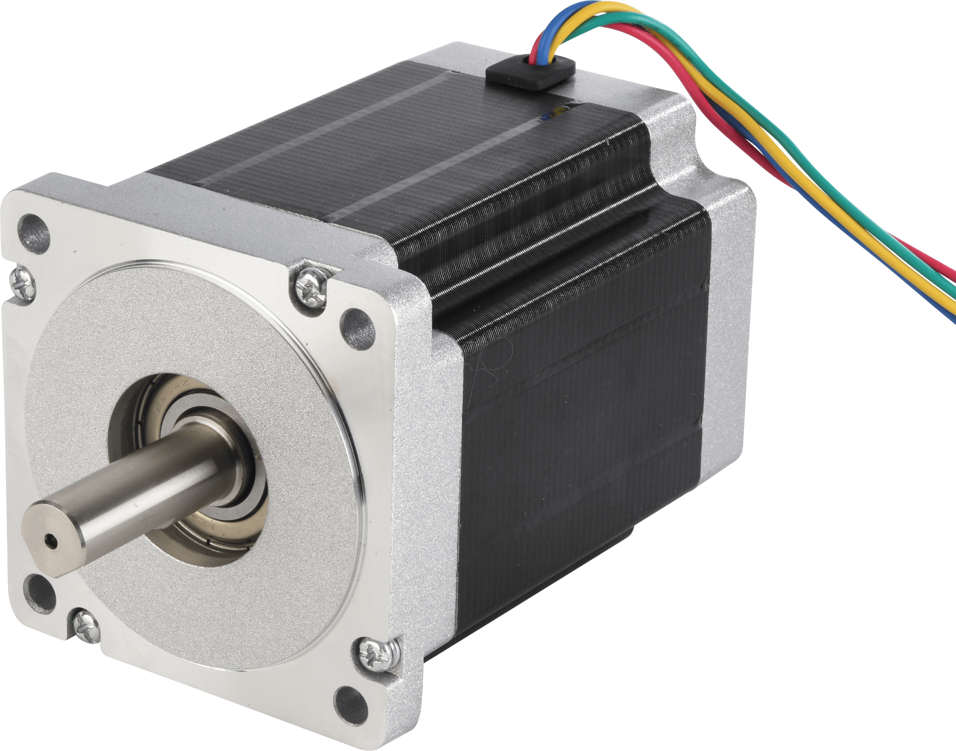
Integrated System Diagram
Route Creation (On Raspi)
App
4G HAT
Raspberry Pi
Receives Route
Receives Location and Route
Sends Data
Sends User Destination
Sends Location and Destination
Override navigation movement control and use obstacle avoidance movement
Obstacle avoidance sensor array detects nearby obstacles
Control motor movement based on current position and next node position
Notes:
Eric

Slide 4
Project Timeline
(Green done, light green near complete, yellow underway, red in trouble, white not started)
Subsystem Designs and Testing (completed 9/11) | Integrate Pathfinder and Movement/Controls and test (to complete by 9/20 | Integration with Android App and Raspberry Pi using cellular data (to complete by 10/5) | Final Integration (to complete by 10/15) | Systems Test (to complete by 11/2) | Validation (to complete by 11/26) | Demo and Report (to complete by 12/5)
Subsystem Designs and Testing (completed 9/11) | Integrate Pathfinder and Movement/Controls and test (to complete by 9/20 | Integration with Android App and Raspberry Pi using cellular data (to complete by 10/5) | Final Integration (to complete by 10/15) | Systems Test (to complete by 11/2) | Validation (to complete by 11/26) | Demo and Report (to complete by 12/5)
*Need to Install Libraries
Notes:
Eric

Slide 5
Nathan Sommer
Accomplishments since last update 13 hrs of effort | Ongoing progress/problems and plans until the next presentation
Integration(App-Pi) Able to send and receive information over different networks through OpenVPN, as well as update the app UI when given GPS | Help with other subsystem’s connections Implement Kill Switch Socket Error Handling (Low Priority) UI Updates(Low Priority)

Slide 6
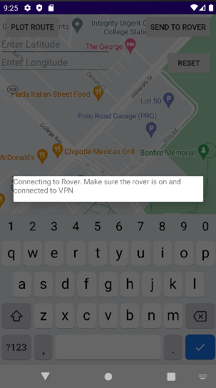
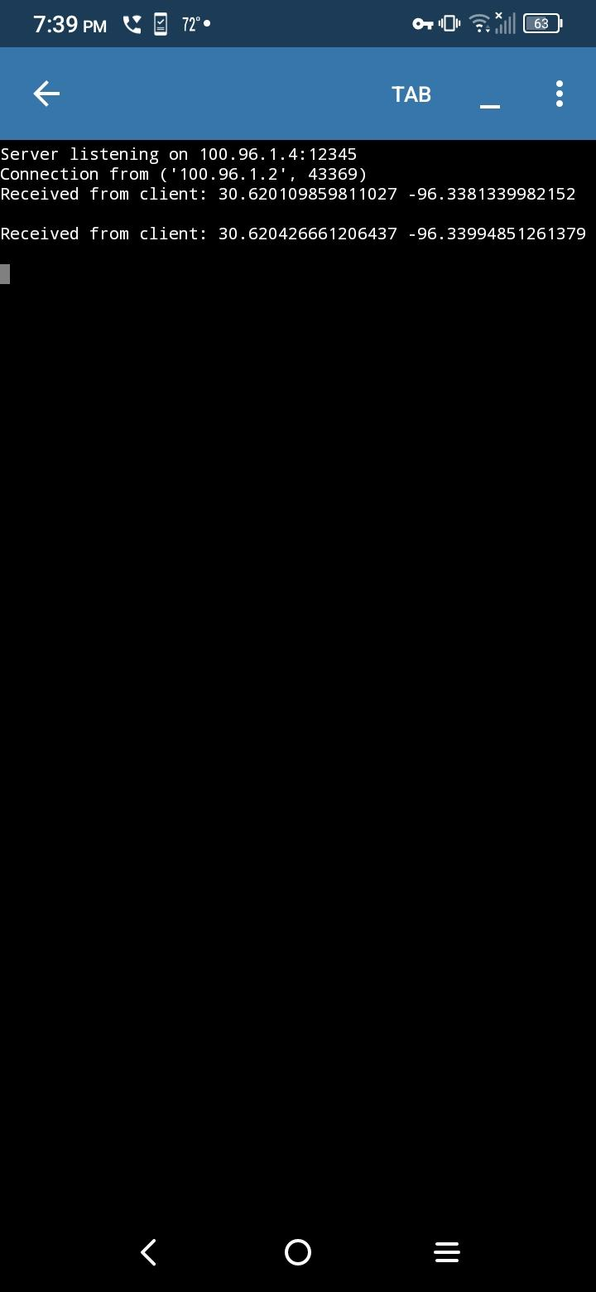
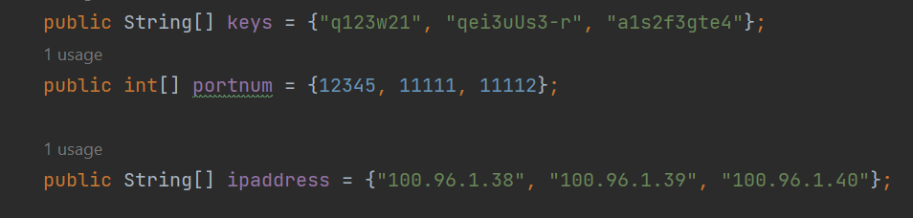
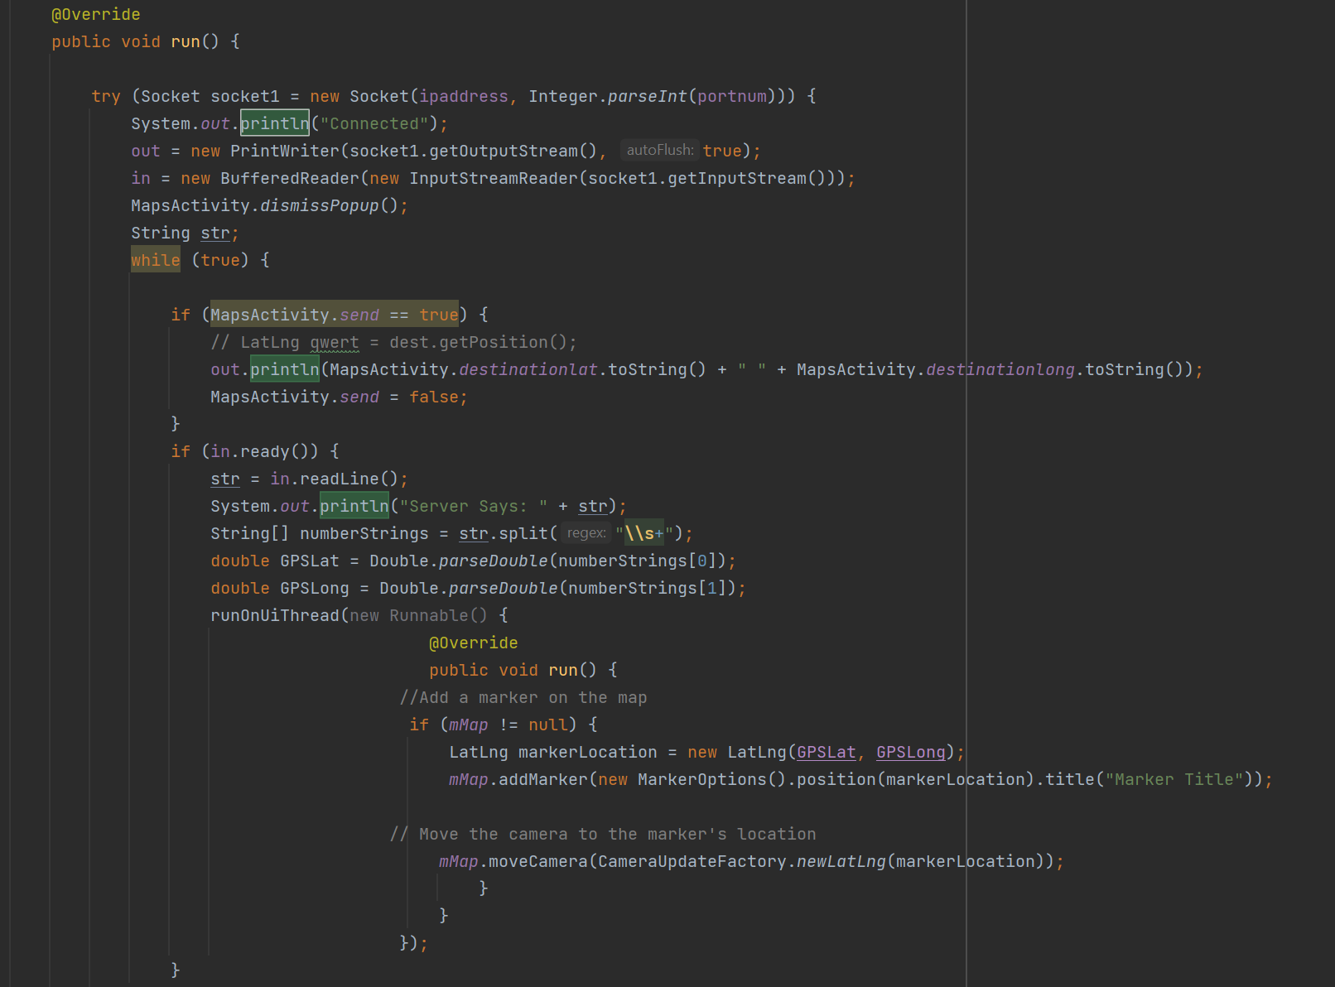
Nathan Sommer

Slide 7
Arkadi Zhanov
Accomplishments since last update 16 hrs of effort | Ongoing progress/problems and plans until the next presentation
Integration (Pathfinder-Pi) Identified integration issues (library version incompatibilities) Pathfinder subsystem is complete and is nearly entirely integrated with other subsystems Integration (Obstacle Avoidance-Pi) Ultrasonic distance sensor readings tested and validated Developed two obstacle avoidance approaches (vector weights / cases) for controls integration Obstacle avoidance code tested, and mostly validated and integrated | Install specific library versions on microcontroller Finalize deployment, testing and validation of pathfinder system 3D print a more stable housing for ultrasonic sensors Pick the better obstacle avoidance procedure Finalize testing and validation of obstacle avoidance system Help with other subsystems

Slide 8
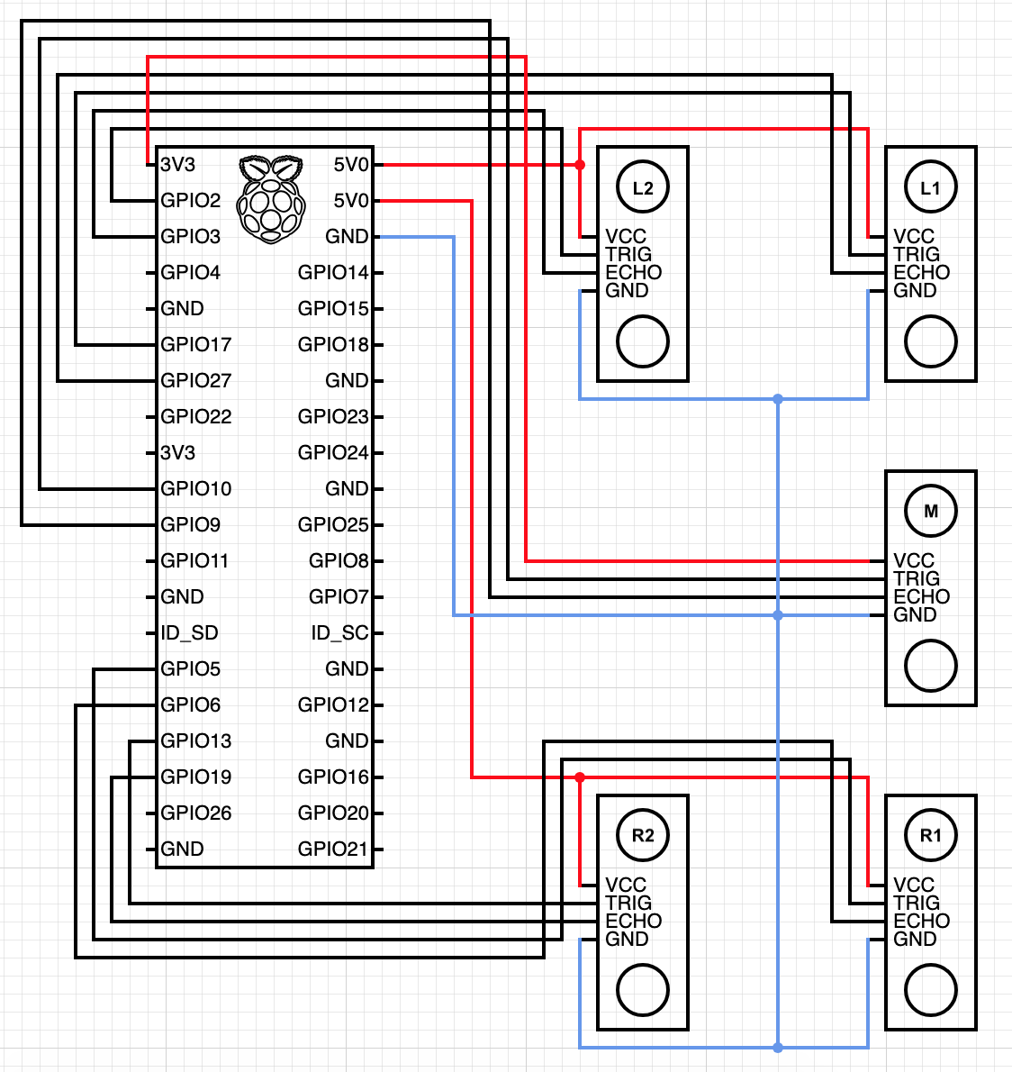
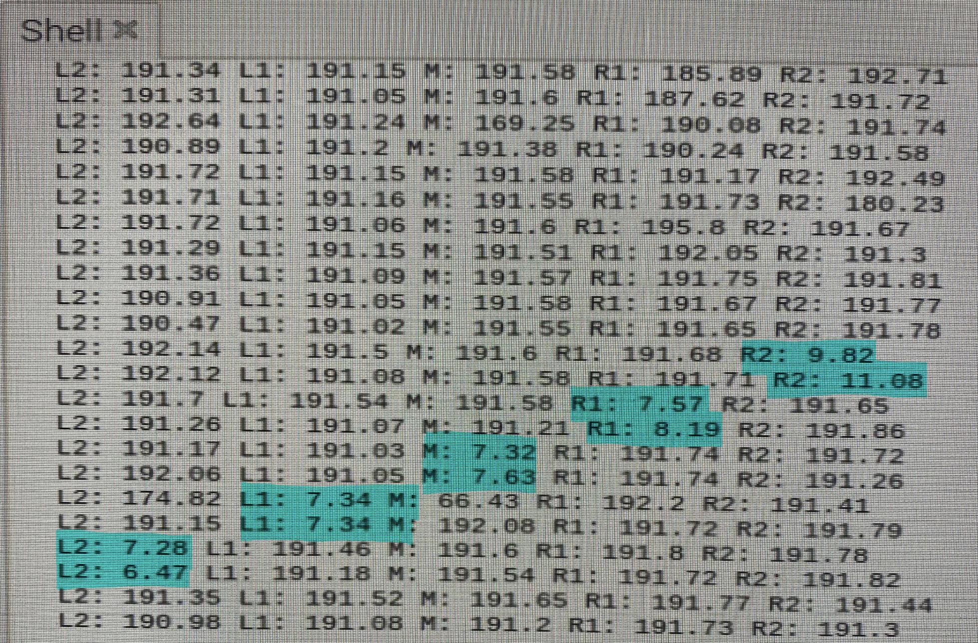
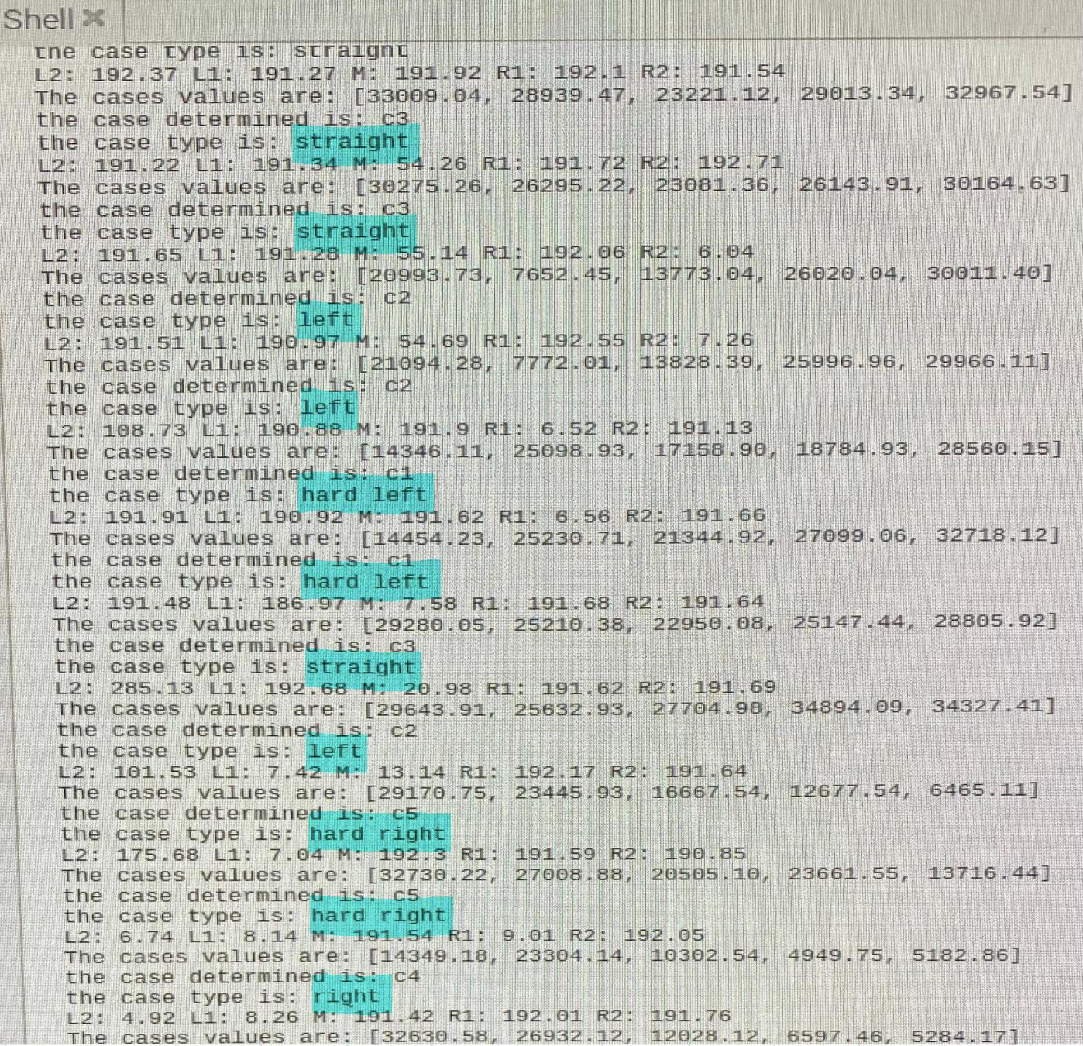
Arkadi Zhanov
Fig 2. Testing and Validating Distance Sensor Readings Before Combining With Obstacle Avoidance
Fig 3. Obstacle Avoidance Testing and Validation
Fig 1. Current Wiring Diagram of Obstacle Avoidance Sensor Array and Microcontroller

Slide 9
Navigation/Movement/Control
Nikolai Paderin
Accomplishments since last update 25 hrs of effort | Ongoing progress/problems and plans until the next presentation
4G Hat -GPS functionality -Able to connect to the 4G cellular network Integration(Pi - App) -Able to send and receive information to and from the application. (tested) -Able to use cellular network to access the internet, enabled on boot up. Integration(Pi-Navigation) -Loaded the Navigation code to the pi. | GPS -Is currently able to pull information, but has issues with booting up. Motor Control -Test functionality with GPS module being used simultaneously. (They both use the same serial port, may have to switch to Pi 4)

Slide 10
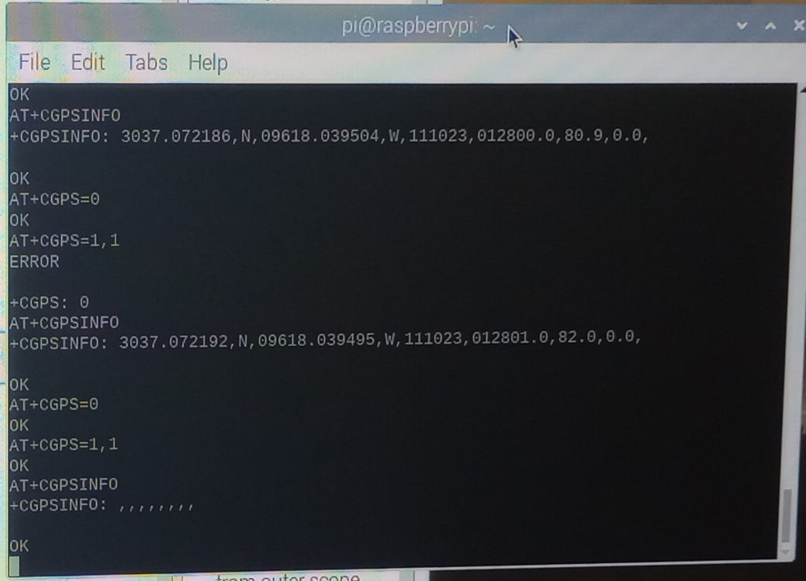
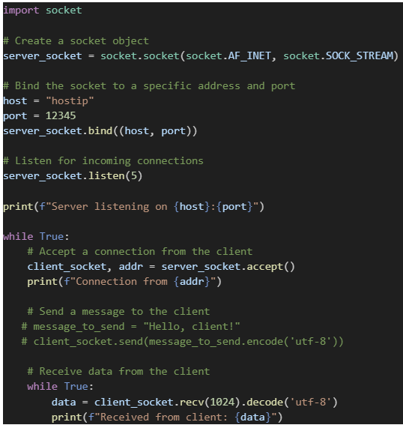
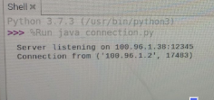
Navigation/Movement/Control
Nikolai Paderin
Able to connect to server and send info
+
Able to request GPS location

Slide 11
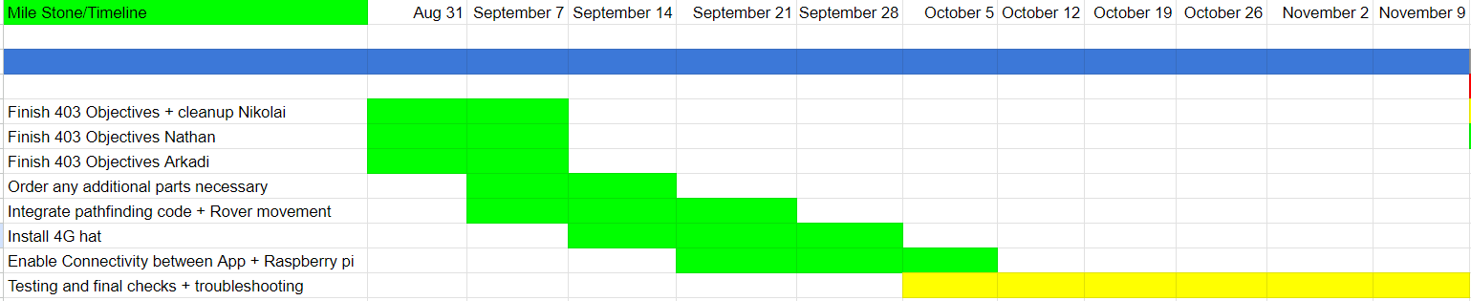
Execution Plan
Notes:
Michelle

Slide 12
SYSTEM Validation Plan
TEST NAME | REQUIREMENT | SUCCESS CRITERIA | METHODOLOGY | STATUS | ENGINEER RESPONSIBLE
403 Cleanup Nikolai | FSR Pg10 | Have all sensors + movement code working and precise | Test sensors, and rover movement by measuring and calibrating | Complete | Nikolai
403 Cleanup Nathan | FSR Pg10 | Add the Connection Page + Help Arkadi with navigation subsystem | Test to see if subsystem is fully operational and working as intended | Complete | Nathan
403 Cleanup Arkadi | FSR Pg10 | Have the navigation/pathfinder code working as intended. | Using two points create a series of nodes that connect them using the code | Complete | Arkadi
Integrate Pathfinding with movement | FSR Pg10 | Have the Raspberry pi communicate with pathfinding code and integrated | Using the Pi, send info to the pathfinding subsystem to create a path | Complete | Nikolai + Arkadi
4G hat connection + integration | FSR Pg10 | Have the Raspberry pi integrated with a 4G hat such that it has internet access wherever it is. | Using the Pi and the 4G hat, give the Pi internet access through a cellular network | Complete | Nikolai
App to Raspi connection | FSR Pg10 | Have the Raspberry pi send and receive information from the App | Test sending information with Raspi and App using sockets | Complete | Nathan + Nikolai
Demo Test/Validation | FSR Pg10 | All subsystems are successfully talking to each other, and can operate autonomously | Use app to get user destination, and see if rover goes to destination using all subsystems | Not Complete | Nathan + Nikolai + Arkadi
Systems Test | FSR Pg10 | System is working as intended | Stress-Check System, and see if everything works as intended | Not Complete | Nathan + Nikolai + Arkadi
Notes:
Michelle

Slide 13
THANK YOU FOR YOUR TIME! ANY QUESTIONS?

